Slide 1
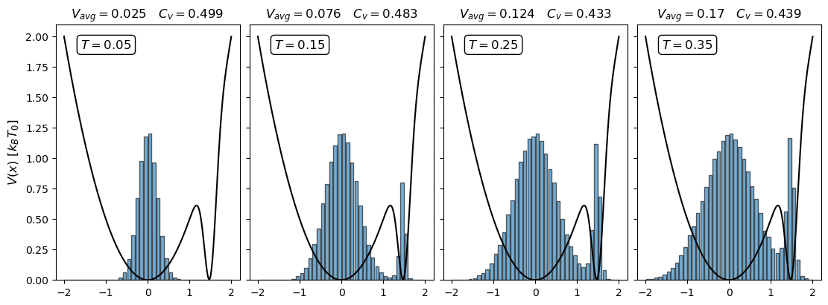
Simulation of temperature

Slide 2
Outline
Brief summary of statistical physics
Metropolis Montecarlo vs. Molecular Dynamics simulations (MD-simulations)
How do they work?
Benefits and disadvantages.
Focus on MD-Simulations
Results from exercises 27 and 28 if time permits

Slide 3
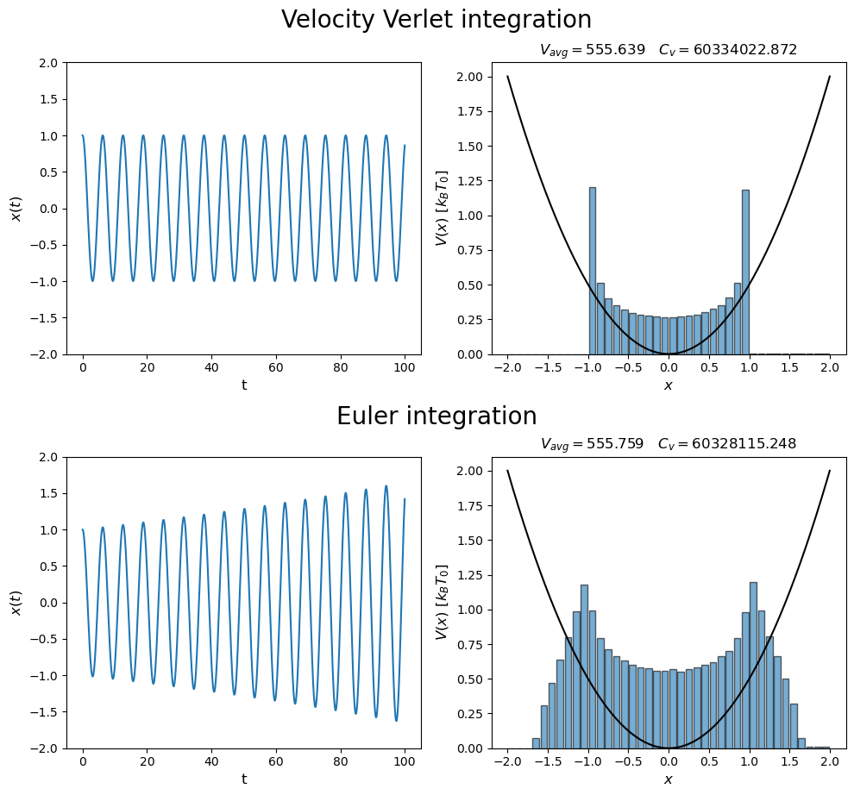
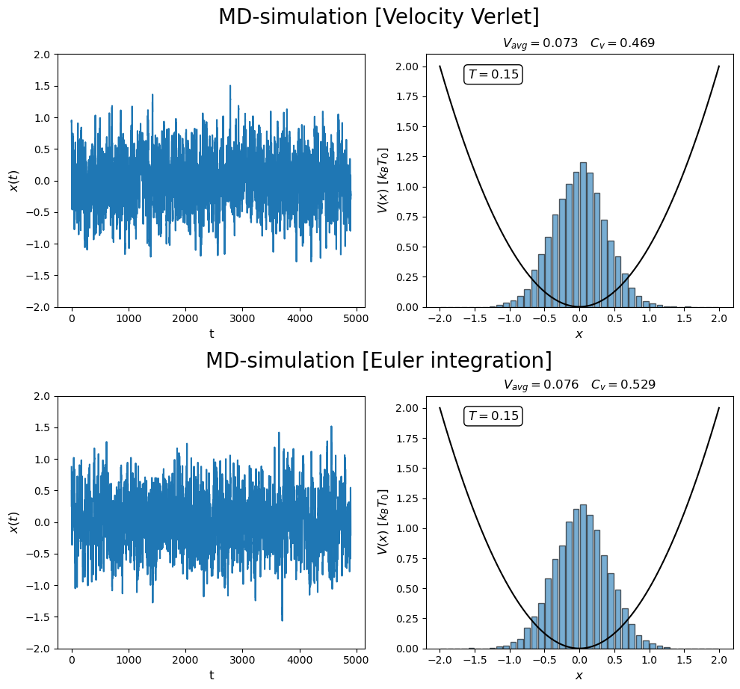
Metropolis Montecarlo vs. MD-simulation
Switch on thermostat

Slide 4
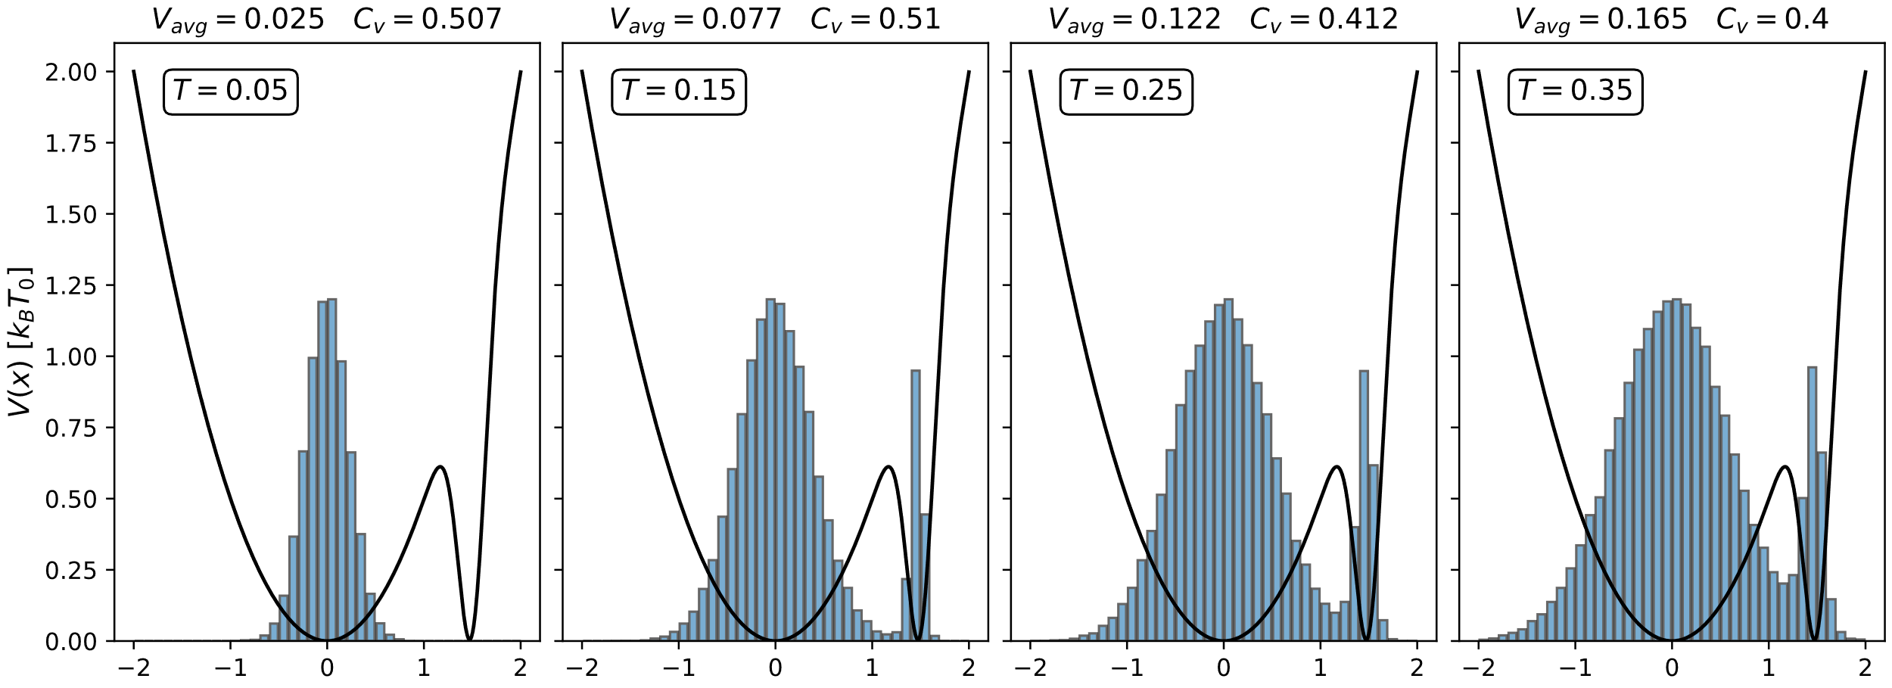
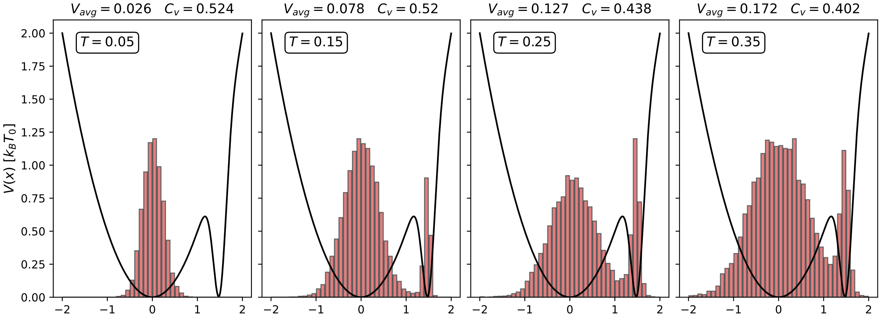
Metropolis Montecarlo vs. MD-simulation
Metropolis Montecarlo
MD-simulations

Slide 5
Metropolis Montecarlo vs. MD-simulation
Advantages/disadvantages
Yield equivalent results
MD-simulations → phase transitions, sim. Annealing …
Both are promising ”optimizers”

Slide 6
Focus on MD-simulations
MD-simulations → Integration of N2
Simulate atomic environments subject to thermostat
Achieve phase transitions & simulated annealing
Velocity
verlet
Euler integration

Slide 7
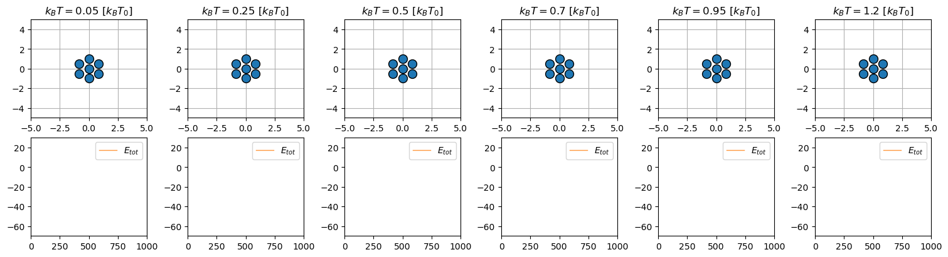
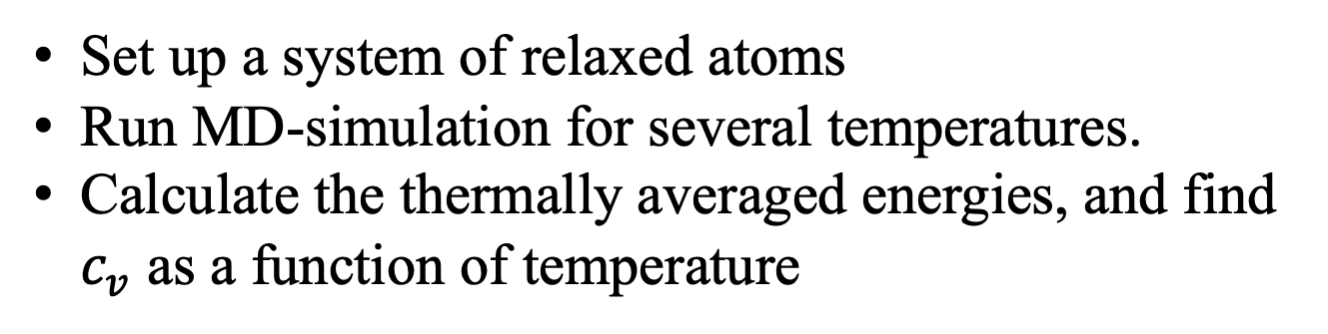
Exercise 27 – find phase transition
Set up a system of relaxed atoms
Run MD-simulation for several temperatures.
Calculate the thermally averaged energies, and find $c_{v}$ as a function of temperature

Slide 8
Exercise 27 – find phase transition

Slide 9
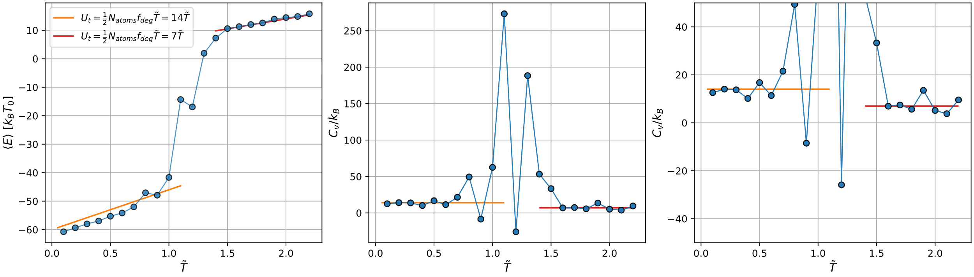
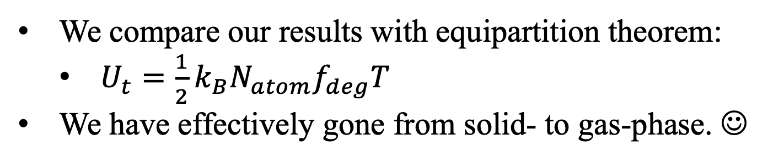
Exercise 27 – find phase transition
We compare our results with equipartition theorem:
$U_{t}=\frac{1}{2}k_{B}N_{atom}f_{deg}T$
We have effectively gone from solid- to gas-phase. ☺

Slide 10
Exercise 28 – Simulated annealing
Set up relaxed atoms → Heat up → Cool down (slowly)
Hopefully end up in more stable structure

Slide 12
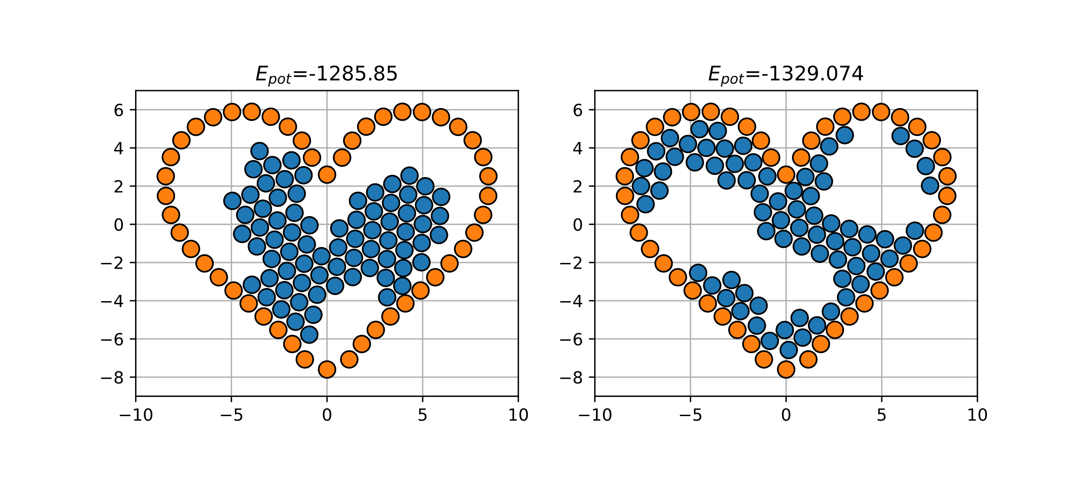
Exercise 28 – Simulated annealing
Finite simulation time

